Slide 1
Organizational Change
Dorie Blackwood B.A., M.B.A.

Slide 2
Outcomes
After completing this module participants will be able to:
Discuss the need for organizational change
Outline the change process
Identify the different roles in the change process
Manage, monitor, and evaluate change
Identify and manage resistance to change

Slide 3
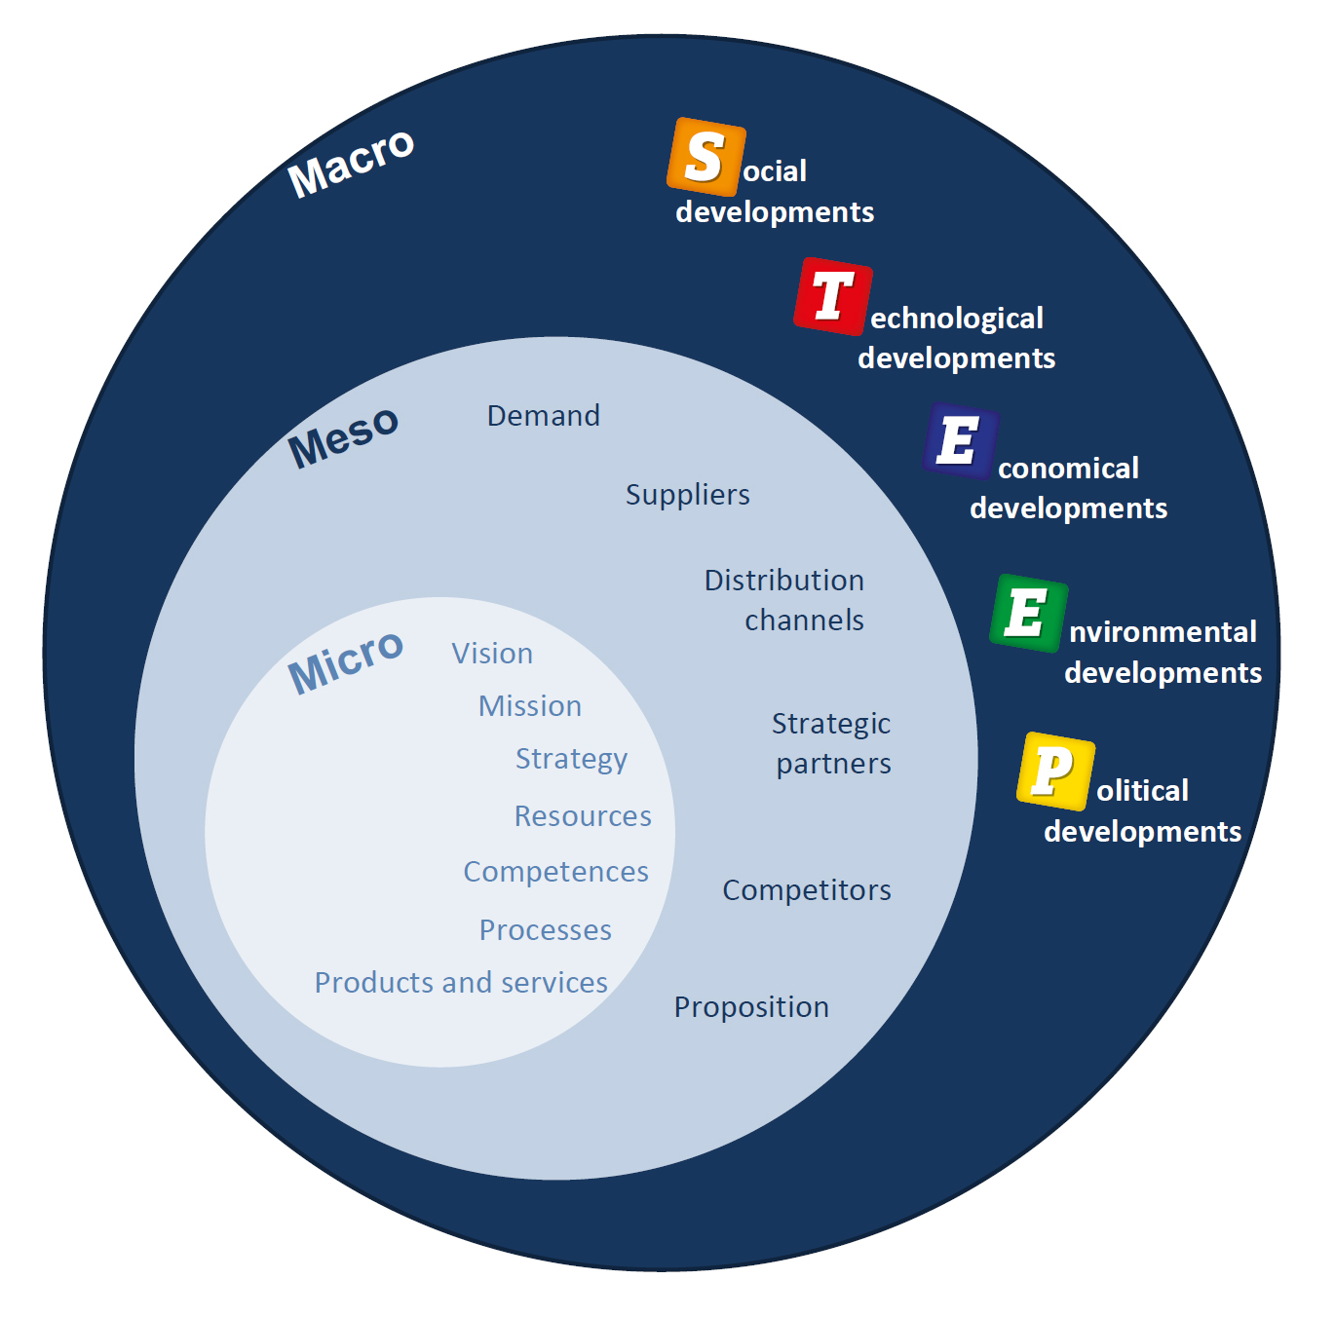
Why do organizations change?

Slide 4
Types of Organizational Change
Strategic – company goals, mission, mergers, and acquisitions
Structural – reporting relationships and groups of business activities
Process – methods, sequence, technology, productivity
People-Centred – culture, attitudes, and motivation e.g. through coaching and mentoring

Slide 5
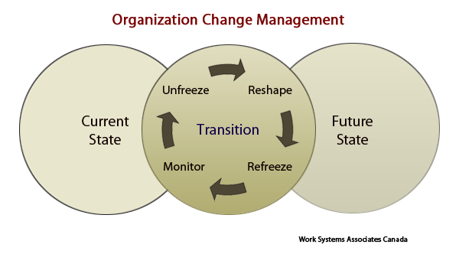
Organizational Change

Slide 6
What is Change Management?
Quite simply, Change Management is the process, techniques, and supporting tools to manage the people-side of change to achieve the required business outcome or outcomes. What is important here is that an outcome is actually achieved (rather than an output), and there is a major focus on people.

Slide 7
What are the key learning points?

Slide 8
Change Management Roles

Slide 9
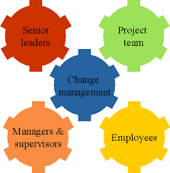
Change Process Roles

Slide 10
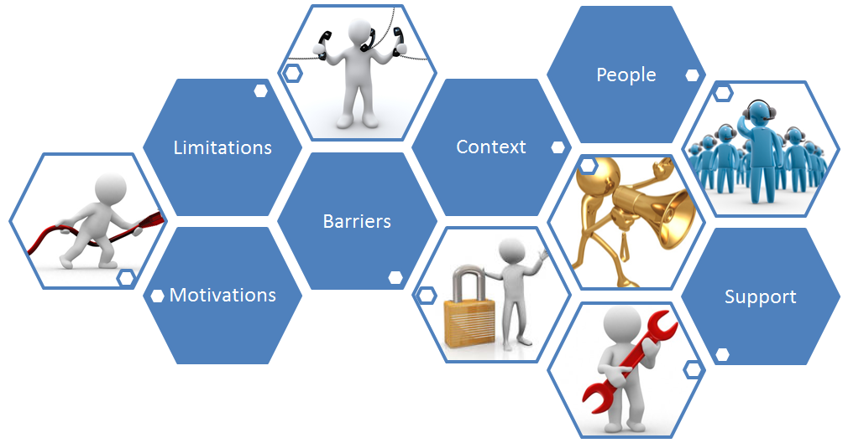
What does this diagram tell you about change?

Slide 11
ADKAR Change Process

Slide 12
Change Mgmt. Tools
ADKAR Stages of Change
Communication
Awareness
Sponsor Roadmap
Desire
Coaching
Knowledge
Resistance Management
Ability
Training
Reinforcement

Slide 13
Activity #1

Slide 14
Feelings Associated With Change
Shock
Denial
Anger
Frustration
Acceptance
Practice
Resignation
Realization
Integration
Elizabeth Kubler Ross

Slide 15
Planning & Implementing Change
Items | Activities
Clear Management Support | Management communication to staff; provision of resources required for successful change
Case for Change | Create logical and detail justification for the change
Employee Involvement | Solicit feedback, buy-in and provide timely explanations
Communicate Change | Take a pro-active approach in the communicating process, timing, needs at each level. Use a structured and systematic approach to communication
Implementation | Make the change – institute new equipment and process. Publish timelines , expectations, and monitoring systems.
Follow-up | Assess change implementation process, and advise the business. Where there are adjustments, document and implement changes.
Remove barriers | Train and motivate. Remove difficult employees.
Celebrate success | Celebrate even small successes towards the desired state

Slide 16
Resistance to Change
Definition:
Resistance to change is the action taken by individuals and groups when they perceive that a specific change is a threat to them
Key words here are “perceive” and “threat”. The threat need not be real or large, for resistance to occur.
In its usual description, resistance refers to change within organizations, although this is found elsewhere in other forms

Slide 17
Resistance to Change
Resistance is the equivalent of objections in sales, and disagreement or stubbornness in general discussions
Resistance may take may forms; active or passive, overt or covert, individual or organized, demonstrated in aggressive or timid actions

Slide 18
Signs of Resistance
Physical illness e.g. complaints of head, stomach, neck, and muscle pain (stress)
Increased absenteeism (or presentee-ism)
Breakdown in communication – increase in rumours, complaints, and conflicts
Decreased productivity
Low morale – consistent negative remarks, and behaviours
Attempts at sabotage

Slide 19
Strategies for Addressing Resistance
Method | How to Use | When to Use | Advantages
Education | Communicate the desired state and reasons for change; | Employees lack information | May increase desire for change;
Participation | Involve potential resisters in designing and implementing change | Change initiators lack sufficient information to design the change | People feel more committed to the change
Facilitation | Provide skills training and emotional support | People fear they may can’t make the needed adjustments because of low skill levels | Training will boost confidence and assure staff they have a role in the future state
Negotiation | Offer incentives for making the change | People will lose (status, income etc) because of the change | People will feel compensated and acknowledged for the sacrifice
Coercion | Threaten loss of job or promotion opportunities; separate or transfer those who can’t or won’t change | Speed is essential and change initiators have considerable power | It works quickly and usually helps resistors

Slide 20
Resistance Management
Identify the symptoms, and use emotional intelligence (empathise)
Acknowledge losses, and recognize the contribution staff made to the organization
Expect and accept mixed emotional responses from employees going through change
Hold ceremonies to celebrate acceptance of the change
Develop a new regimen to stabilize employees

Slide 21
Resistance Management
Emphasise the need for change, and be honest about how change will affect staff
Share information early, fully, and honestly (especially about uncertainties)
Encourage employees to share openly
Provide counseling support for those who require it
Help set priorities (short, medium, and long term)
Reward and praise publicly, and frequently, those who exhibit actions that support the change
Identify areas for improvement, and tailor training for individual needs

Slide 22
Successful Organization Change Management (OCM) Strategies
Agreement on common vision for change
Strong executive leadership to communicate the vision, and sell the business case for change
Education strategy to inform staff how their work will be impacted
Measurement and evaluation of success factors
Rewards and motivation to encourage staff to take ownership and responsibility for their new roles

Slide 23
Monitoring/Evaluating Change
Results versus goals
Quantitative outputs relative to prior performance (response time, waste, productivity, quality)
Workflow
Issues log (concerns and problems)
Survey (users, customers, and staff)
Organizational health surveys
Status reports
Trend Analysis

Slide 24
Activity #2
“It is by changing that things find Rest” (Heraclitus)

Slide 25
Activity # 2
Group Case Study

